Slide 1


Objective: Student will be able to apply the properties of integer exponents to generate equivalent expressions.
Bell Work
Solve the following:
$$2^{4}=$$
$$2^{3}=$$
$$2^{2}=$$
$$2^{1}=$$
$$3^{4}=$$
$$3^{3}=$$
$$3^{2}=$$
$$3^{1}=$$
Do you notice a pattern?
Any idea of what $2^{0}$ or $3^{0}$ might be?

Slide 2
Unit: Exponents & Scientific Notation Topic: Properties of Exponents

Slide 3
To classify numbers first simplify Find any square roots and divide fractions

Slide 4
We know that $3^{3}$ means 27
In the example above, $3$ is called the base and the little 3 is called the exponent.
The exponent tells us how many times the base is multiplied together

Slide 5
$$x^{5}$$
exponent
base

Slide 6

Describe the pattern with exponents if they have the same base:
$$2^{4}=$$
$$2^{3}=$$
$$2^{2}=$$
$$2^{1}=$$
$$2^{0}=$$
$$2^{−1}=$$
$$2^{−2}=$$
$$2^{−3}=$$
$$2^{−4}=$$
Pattern:
Answers are being cut in half because the base is 2

Slide 7
Anything to the power of zero is ONE
$$3^{0}=$$
$$x^{0}=$$
$$y^{0}=$$

Slide 8

Power to a Power:
When an exponent is raised to another exponent, the exponents can be MULTIPLIED
In other words, $(x^{a})^{b}=x^{a∙b}$
Examples:
$$(x^{3})^{2}=$$
$$(x^{2}y)^{4}=$$
$$(2m)^{3}=$$

Slide 9

Multiplication:
When multiplying and the bases are the same the exponents can be ADDED together
In other words, $(x^{a})(x^{b})=x^{a+b}$
Examples:
$$(x^{2}{)(x}^{3})=$$
$$(3^{−2})(3^{5})=$$
$${(y}^{4})(y)=$$

Slide 10

Dividing Like Bases:
When like bases are being multiplied, their exponents can be SUBTRACTED
In other words, $(x^{a})÷(x^{b})=x^{a−b}$
Examples:
$$(x^{4}{)÷(x}^{2})=$$
$${(x}^{7})÷(x^{2})=$$

Slide 11
Negative Exponents:
When an exponent is a negative number, we can think of it as taking the RECIPROCAL
In other words, $x^{−n}=\frac{1}{x^{n}}$
Here’s another way to visualize what happens when an exponent is negative:
$${base}^{negative exponent}=\frac{1}{{base}^{positive exponent}}$$
We don’t want to leave negative exponents in our solutions, so use this rule to help you write all solutions with a positive exponent.

Slide 12
Negative Exponents:
CROSS THE LINE CHANGE THE SIGN

Slide 13
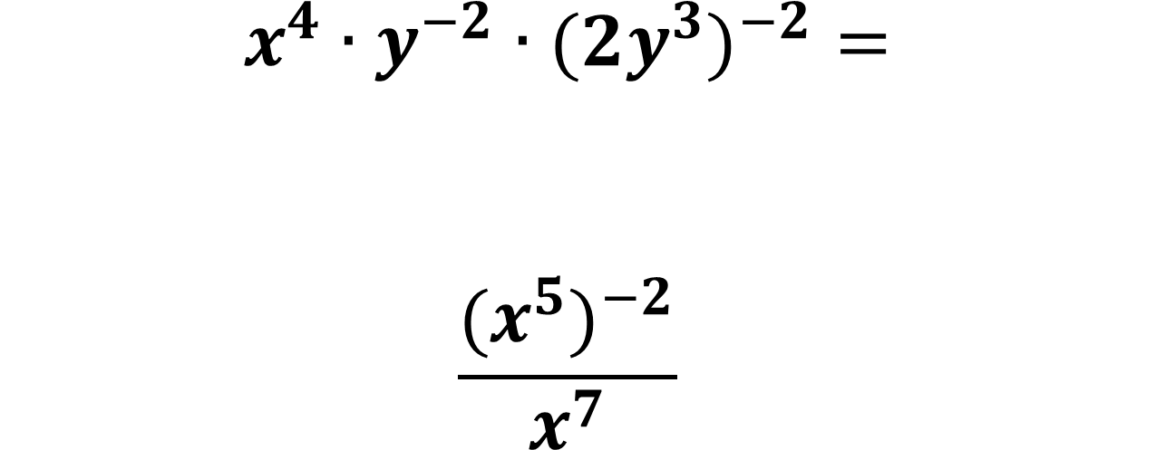
Mixed Review:
$$x^{4}∙y^{−2}∙(2y^{3})^{−2}=$$
$$\frac{{(x}^{5})^{−2}}{x^{7}}$$

Slide 14


Mixed Review:
$$8^{7}∙8^{3}=$$
$$q^{9}÷q^{6}$$
$${(4}^{8})^{2}=$$
$$m^{3}×m^{0}$$

Slide 15


Mixed Review:
$$\frac{7^{2}∙7^{5}}{7^{3}}=$$
$${(b}^{5})^{3}×b^{4}=$$
$$\frac{{15}^{4}}{{15}^{2}}×{15}^{7}=$$
$${(w}^{2})^{1}×w^{0}=$$

Slide 16



Mixed Review:
$$5^{2}×5^{2}$$
$$\frac{{(2}^{3})^{2}}{2^{5}}$$
$$\frac{q^{5}}{q^{2}}$$

Slide 17



Mixed Review:
$$\frac{6^{9}}{{(6}^{3})^{2}}$$
$$(8^{2})^{1}×8^{0}$$
$$(1^{4})^{2}×(1^{3})^{4}$$

Slide 18


Label the following equations as true or false.
$$\frac{a^{−8}}{a^{3}}=\frac{a^{−17}}{a^{−6}}$$
$$z^{−7}×z^{2}=z^{7}×z^{−2}$$

Slide 19


Label the following equations as true or false.
$$\frac{8^{−6}}{8^{2}}=(8^{−4})^{−2}$$
$$\frac{b×b^{4}}{b^{10}}=(b^{5})^{−1}$$

Slide 20
Homework Assignment: Real Number System HW 1

